Slide 1
Shell Bootcamp 2024 Reflections for the training
10/09/2024 to 13/10/2024
Sakshi Neeraj
Date : 13-Sep-2024

Slide 2
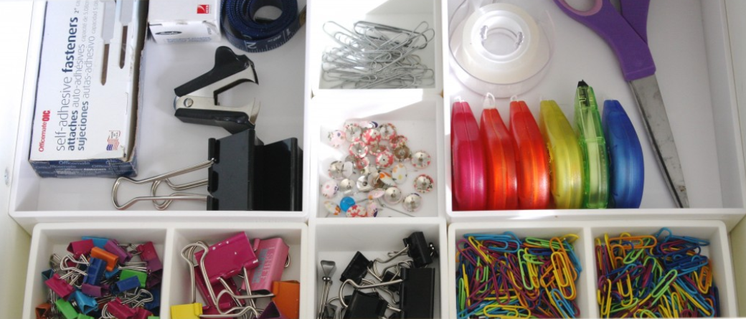
About Me
B. Tech Computer Science Engineer
Specialized in Data Science and Analytics
Permanent resident at Delhi
Organized
Good at time management
Hobby is cooking
Organized
Organized and managed

Slide 3

My learnings from this week!

Slide 4
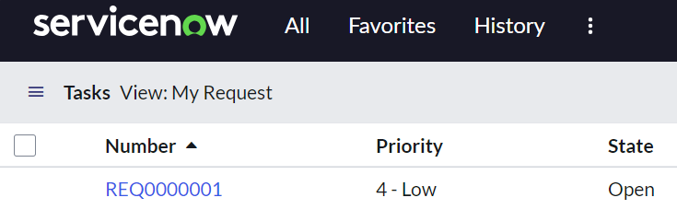
Learning 1 | My takeaways (10/09/2024, 11/09/2024)
Learnt about Information Technology Infrastructure Library (ITIL)
ITIL helps raise service requests and tickets for incidents and problems
Information Technology Service Management is the tool used to perform ITIL
ServiceNow is the platform used to raise IT related requests
Service Request
Problem Management
Change Management
SLA Management
Service Request raised at ServiceNow platform

Slide 5
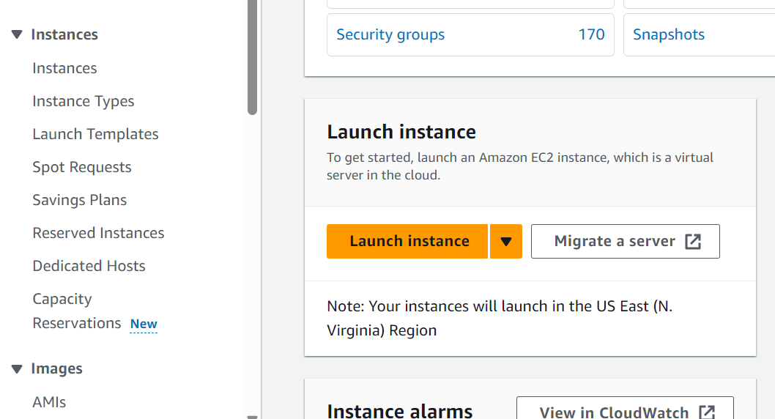
Learning 2 | My takeaways (12/09/2024, 13/09/2024)
Cloud platforms are either-
IaaS
PaaS
SaaS
Clouds can be either public, private or hybrid
Elastic Compute Cloud instance is used to create virtual machines to deploy applications and perform high computations
EC2 can be linked to block storage using volumes
S3 storage is object storage which stores files in it
Making an EC2 instance

Slide 6

Relevance of learnings for my organization

Slide 7
Learning 1 and 2 | Relevance for Shell
ITIL tools like ServiceNow provide an integrated platform for managing all requests like service requests, change management and incident management
For an organization like Shell it is important that all the requests and processes go through a set procedure to reach the resolution stage to keep a track of all the steps
This will make the processes more smooth and systematic in practical usage

Slide 8
Learning 3 and 4 | Relevance for Shell
Cloud computing services provide an organization the liberty to host their applications seamlessly and smoothly without taking care of the underlying infrastructure architecture
Knowledge about cloud computing platforms like AWS helps to create virtual machines which in turn provide high computing power in case of heavy application development
Cloud also provides Data Storage facilities making analysis of data easier and smoother using services like AWS Athena or Dynamo DB

Slide 9

Challenges in implementing learning

Slide 10
Challenge faced while implementing Learning 1 and 2
Managing ITIL requests and following their set step-wise procedures is extensive
Being familiar with the user interface of ServiceNow needs practice and time

Slide 11
Challenge faced while implementing Learning 3 and 4
Operating virtual machines needs time and practice
Creating all the instances of EC2 taking in adherence to the billing costs is important

Slide 12

Action Plan

Slide 13
My Action Plan for this Week
Actions
Timeline
Status
Learn about DevOps tools like Terraform and Docker
In the next week, learn about DevOps tools
Completed Cloud Computing foundations

Slide 14

Learning is also Fun!

Slide 15
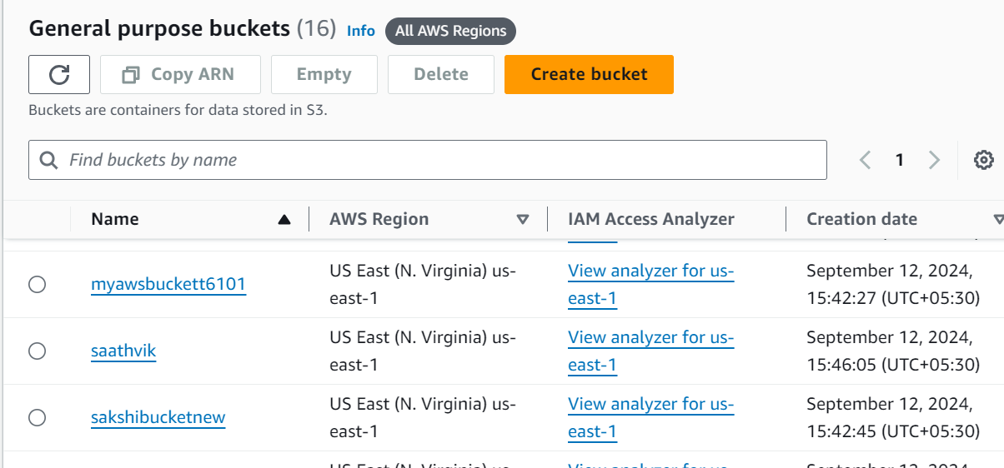
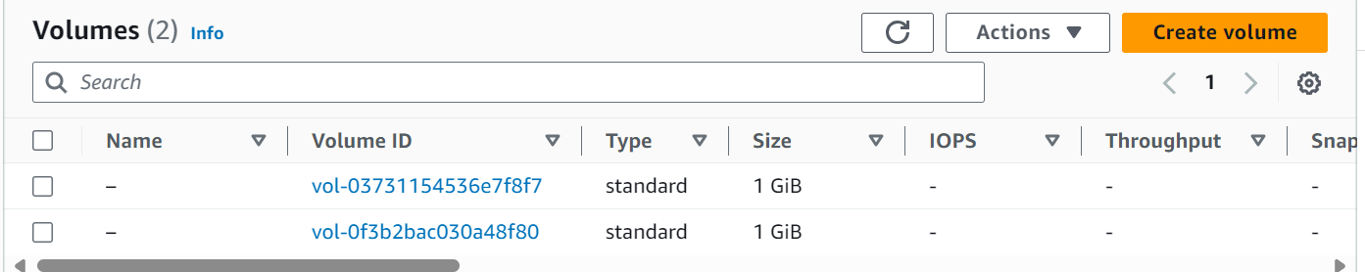
Learning is also Fun!
Making an EC2 instance
S3 buckets
Attaching a volume to EC2 instance

Slide 16

Summary
Learnt about ITIL and tools used in ITSM like ServiceNow
Learnt about-
Incident Management
Change Management
SLA
Created an EC2 instance with volume of 1GB storage attached to it on AWS
Gained practical knowledge on Azure

Slide 17
Thank You

